Slide 1

Million Coursework Student
Notes:
kunDU

Slide 2
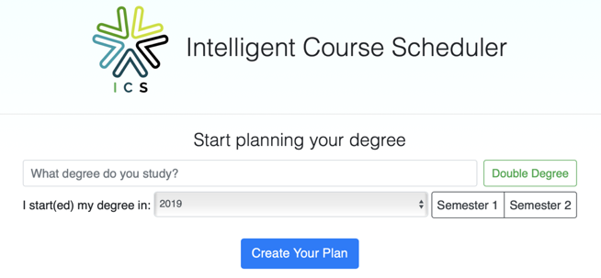
Introduction
This project will enhance the former Intelligent Course Scheduler project in the Customization Interface area so that the ANU Student Services staff could maintain the data.
Notes:
kunDU

Slide 3

Sprint Review
Notes:
kunDU

Slide 4

Problems Facing and Overcoming
Management
Division of Labor
Decision-Making
Communication
Reflection

Slide 5
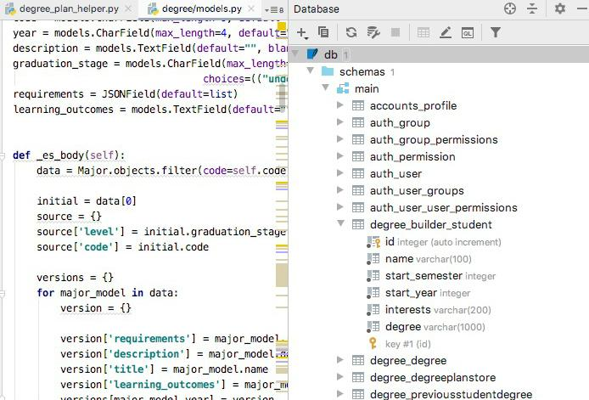

Technical Problems
Database & Elasticsearch - Confusing Structure
Notes:
rui

Slide 6
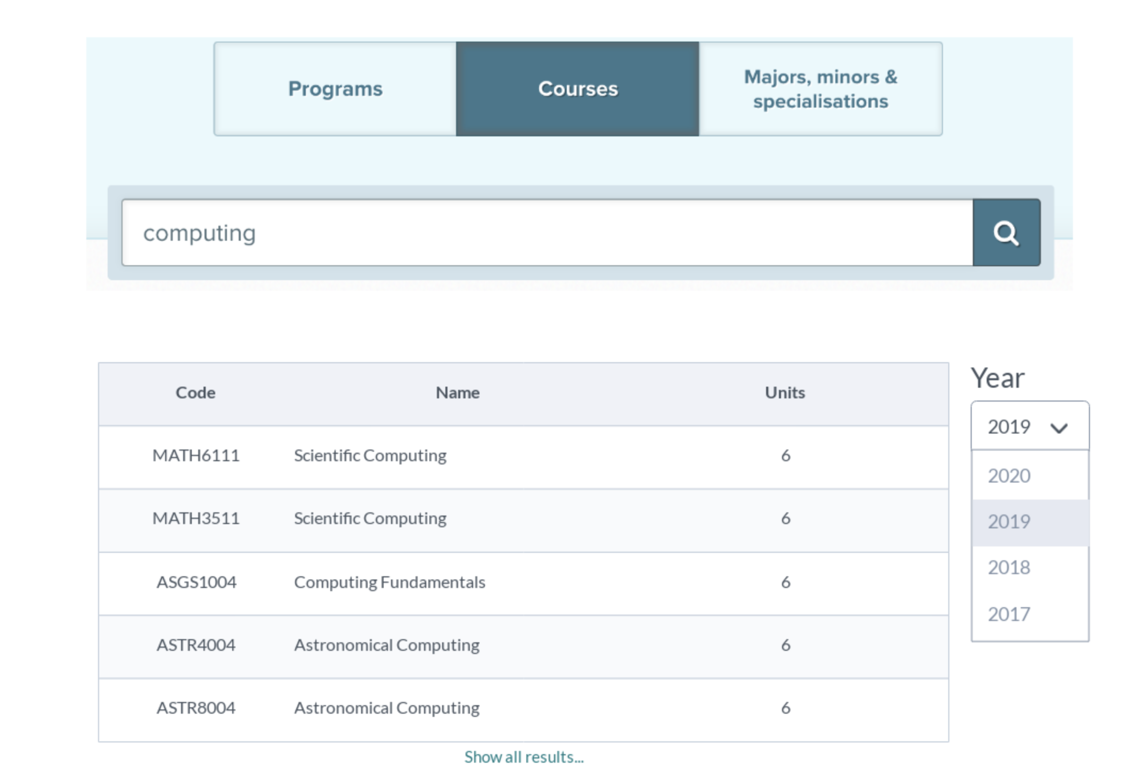
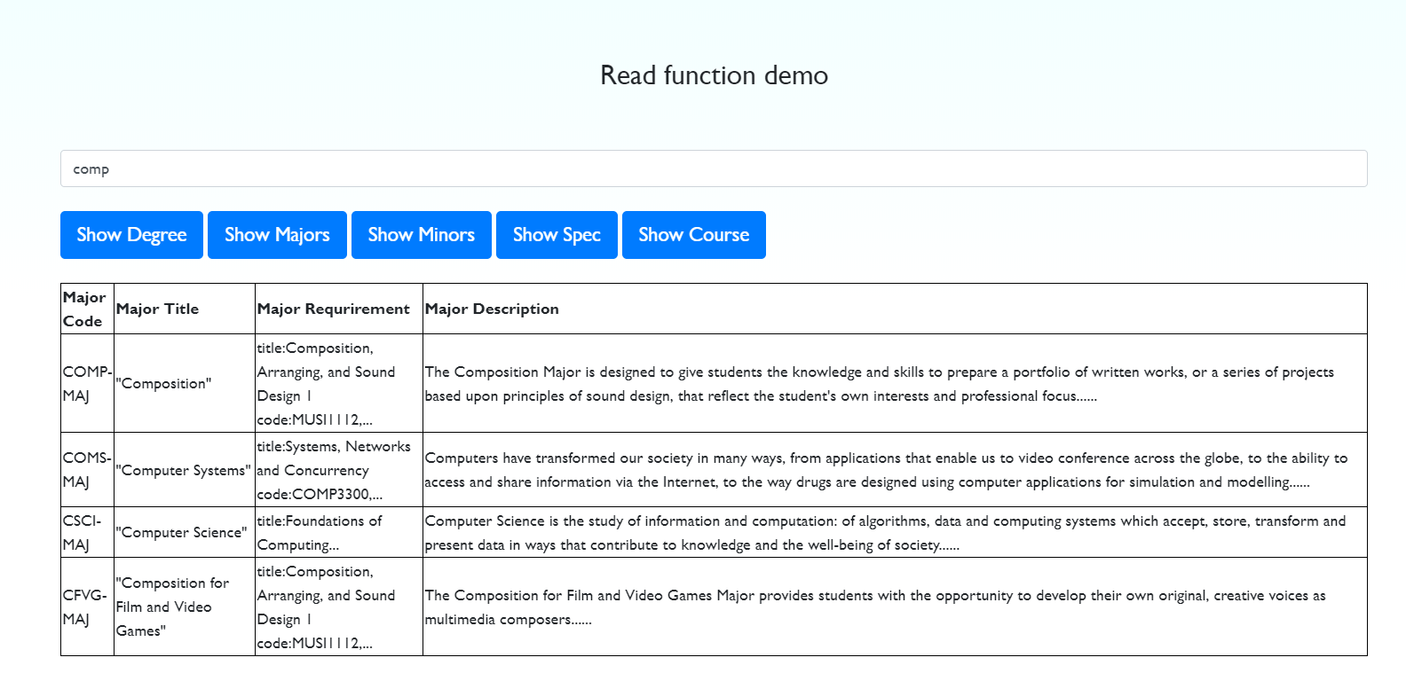
Technical Problems
User Interface Design
We created a few UI templates and get design improved from feedbacks
e.g. some our UI templates

Slide 7
Non Technical Problems
Overestimate - Unfinished Task in Sprint 1
After careful evaluation and trade-offs, a decision to defer the create-function was made.
Busy user - ANU Student Services staff
Made flexible adjustments to conduct early UI testing
Notes:
rui

Slide 8
Roles and Activities
● Kundu Gui(Project Manager)
○ Organize works and activities
○ Summarize project process
● Yichen Li(Testing Manager)
○ Write testing report and plan
○ Contact CECS
● Zifeng Liu, Lingyu Xia, Rui Zhang (Developer)
○ Understand project structure
○ Develop read function
Notes:
Liu

Slide 9
Roles and Activities
● Xiangyu Chen(User Experience Researcher)
○ Research of user preference
○ Design user interface
● Sayed Zulfikar(User Experience designer)
○ Write testing report and plan
○ Design user interface
Notes:
Liu

Slide 10
Plan For Next Sprint
● Read function development
○ Read details of degree, major, minor, specialization, and course
○ Test read function with at least 30 people
● Create function development
○ ANU Staff could create new degree, major, minor, specialization, and course
Notes:
Liu

Slide 11

DEMO
Notes:
CHEN

Slide 12

Question

